Slide 1

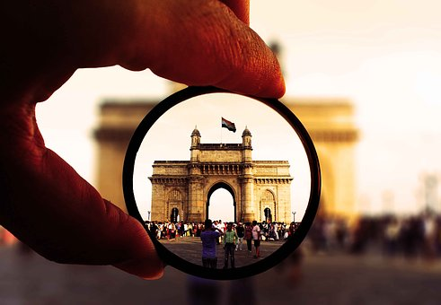


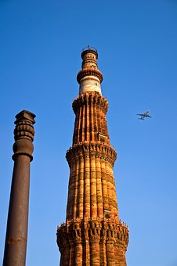
TCSへようこそ！ Welcome to TCS
Notes:
1
1

Slide 2
,
Customer Executives
Prudential Leadership
Mr. George Sinnott - Vice Presidency, Delivery
Mr. John Glooch - Vice President, Business Technology Officer
Mr. Gagan Puranik - Vice President, Strategic Sourcing
Ms. Rachel Morgan - Director, Strategic Sourcing
Mr. Gennadiy Belenkiy - Vice President, Business Technology Officer
Mr. Genta Hatakeyama – PHJ Digital Application Lead
Deloitte Attendees
Ms. Heather Rangel
Ms. Tomiko Partington
TCS Team
Pune
Mr. Sethumadhavan Lakshmanan – Managing Partner & VP, BFSI Americas
Mr. Milind Karve – JDC Service Delivery Head & VP, JDC
Mr. Laxmikant Shaligram – Service Delivery Deputy Head, JDC
Mr. Nitin Shukla – Unit Owner, BFSI Americas
Mr. Pushparaj M – Delivery Head, BFSI (US), BFSI BG
Mr. Sagar Borgaonkar – Head of SBP & Strategic Initiatives, JDC
Mr. Sayyad Abbashaider – Head of Sales & Solutions, IT IS, JDC
Mr. Muddasir Kazi - Lead Solutions Architect, IT IS, JDC
Ms. Shilpa Vairagkar – Presales Consultant, JDC
Ms. Renuka Saldhana – Talent Development, JDC
Mr. Sreedeep P – Team Lead, BFSI (US), BFSI BG
Ms. Nivedita Kulkarni – JDC Customer Experience & Presales
Mr. Avinash Muley – JDC Customer Experience & Presales
Notes:
2

Slide 3
AGENDA
6th Nov 2025 (Thursday) – A1 Boardroom
Start Time | End Time | Dura Tion | Agenda | Alignment with Customer Interest | Presenter (s)/ Stories | Location
11:00 | 11:20 | 0:20 | Reception & Security and Welcome Introductions | - | Avinash | Gate-2
11:20 | 11:35 | 0:15 | TCS Prudential Relationship Overview and | - | Sethu | A1 Boardroom
11:35 | 12:00 | 0:25 | JDC & JDM Overview Japan AI COE connect | Meet vendor leaders to assess strategic fit, executive commitment, and readiness to support Prudential’s Japan and US needs, Overview of Japanese clients & services provided | Milind/Shali, (Misawa) | Hikari Academy, S2 GF
12:00 | 12:30 | 0:30 | Talent Review+ Hikari Academy Walkthrough & Language Initiatives | Talent/People (including language) •Recruitment approach, talent sources, and available bench with focus on Japanese skills • Talent retention and quality (approach, best practices, specific initiatives) • Culture, language and talent development / training | Sagar & Renuka | Hikari Academy, S2 GF
12:30 | 13:00 | 1:00 | IT Infrastructure Services -Digitally Managed Services Overview | - Vendor capabilities overview – Services, Platforms Service capabilities with perspectives on Japan-specific dynamics | Abbas / Muddassir | Hikari Academy, S2 GF
13:00 | 13:30 | 0:30 | Infrastructure Floorwalk - PRISM™ Floor walkthrough | Infrastructure Portfolio | Unmesh | S3 1F
13:30 | 14:30 | 1:00 | Lunch |  | All | A1 Poolside EDR
14:30 | 15:00 | 0:30 | Floorwalk + Interaction with Japan Teams Takenaka (Data) | Digital Transformation, Working with Japanese clients. | Rahul Patil | S2 4F
15:00 | 15:30 | 0:30 | MISOL (ITO, Security, ISM) Floorwalk | Service capabilities with perspectives on Japan-specific dynamics , Tool and accelerators, Floorwalk, Security | Shishank | S3 5F
15:30 | 16:00 | 0:30 | AMS /ADM session– 20 mins Transition Approach – 20 mins | - Vendor capabilities overview – Services, Platforms Service capabilities with perspectives on Japan-specific dynamics - Transition approach | Prashant / Prathamesh | A1 Boardroom
16:00 | 16:30 | 0:30 | Commercials Approach for Japanese Clients | Commercials Options | Pushparaj, Prasad, Sagar | A1 Boardroom
16:30 | 17:00 | 0:15 | Wrap-up & Feedback | Action Items and confirm next steps • Evidence / document needs for post-visit follow up - Touchbase on commercials options. | All | A1 Boardroom
Notes:
3

Slide 4



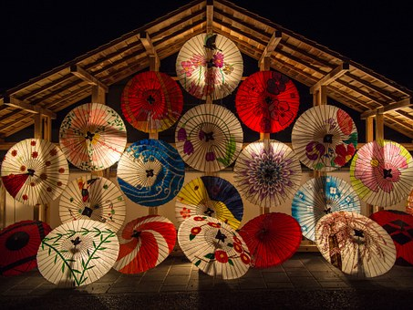


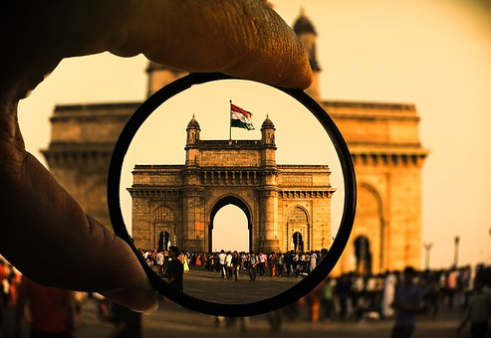
ありがとうございました

